Slide 1


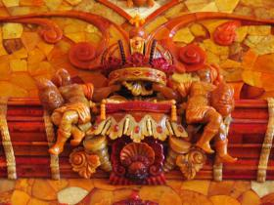
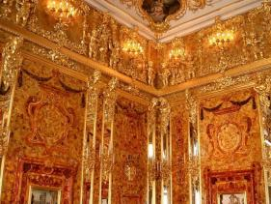
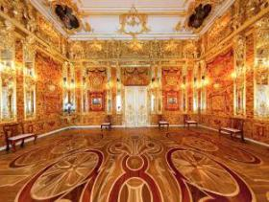
Unit 1 Cultural relics
Reading

Slide 2


While-reading
Read and and finish the tasks as quickly as possible.

Slide 3

Task 1
Match the main ideas and the paragraphs.
Para 1
How did the Amber Room become
one of the wonders of the world?
Para 2
How was a new Amber Room built?
Para 3
How did the Amber Room get lost?
Para 4
How was the Amber Room made?
Para 5
Why did the King of Prussia give
the Amber Room to the Czar of
Russia as a gift?

Slide 4

What's the basic information about the Amber Room? Fill in the blanks.
Task 2
yellow-brown
color ____________
Prussia
birthplace ___________
the Amber Room
in the fancy style popular in those days
design _____________________
seven thousand tons of amber; gold and jewels
material ________________________
It took a team of the country's best artists ten years to make it.
time to
complete it ____________________

Slide 5

A story is series of events that happen in a particular order. What's the story of the Amber Room? Fill in the blanks about the main events.
Task 3
Put the sentences in the correct order.
2
Frederick WilliamⅠgave the Amber Room to
_____________ as a gift.
2) ________ gave Frederick WilliamⅠhis best soldiers.
3) The Amber Room was made for ___________ .
___________ removed art objects from the Amber Room.
5) More details were added to the room's design.
6) The Amber Room was taken apart (拆除) and moved
away by _________.
7) A New Amber Room was built.
8) _____________moved the Amber Room to the
palace outside St Petersburg.
Peter the Great
3
The Czar
1
FrederickⅠ
6
The Russians
5
7
the Nazi army
8
4
CatherineⅡ

Slide 6



Task 4
True or False.
1) The design of the room was fashionable in those days.
2) The room was decorated with amber and gold.
3) The room was made to be a gift.
4) The Amber Room became part of the Czar's winter palace and served as a small reception hall for guests.
5) CatherineⅡmoved the Amber Room to a palace in St Petersburg.
6) In 1941, The Nazis and the Russians were fighting.
7) It was too late for the Russians to remove the Amber Room before the Nazis got there.
8) CatherineⅡkept the Room the way it was before.
9) It was clear that the pieces of the Amber Room were once put on a train for a German city.
10) A new Amber Room was built in St Petersburg.
gold and jewels.
not made to be a gift.
important visitors.
had the Amber Room moved to a palace outside
changed the room completely the way she wanted.

Slide 7
Post-reading
mindmap, retelling

Slide 8


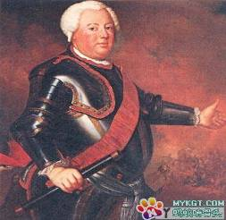
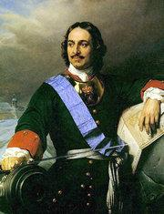
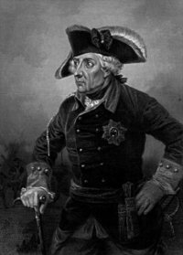


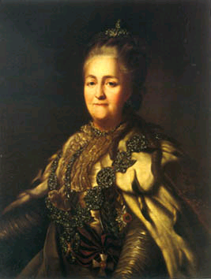
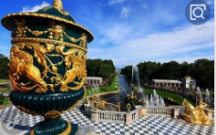

Germany
Russia
1716
Frederick William I
Frederick I
Peter the Great
The Amber Room was made for the palace of Frederick I.
Frederick WilliamⅠdecided not to keep it.
Peter the Great got the gift. In return, the Czar gave William the best soldiers.
1941
1770
2003
Catherine II
The Russians and Germans have built a new Amber Room in St Petersburg after studying pictures of the old ones.
St Petersburg
The Amber Room was taken apart and put on a train for Königsberg. After that, it was a mystery.
She had the Amber Room
moved to the palace outside of St Petersburg and changed it.

Slide 9

The Amber Room, the best and biggest work of amber art that ever ______________(make), was first built for the palace of Frederick I. In 1716, Frederick William I gave it to Peter the Great ______a gift and __________he got some of the Czar's best soldiers. ______ the Amber Room became part of the Czar's winter palace in St. Petersburg and __________ a small reception hall for important visitors. Later, Catherine II told her artists to add more details to it. Unfortunately, in September, 1941, When Russia and Nazi Germany ___________, the Amber Room was secretly _________ the Nazis. 100,000 pieces of the room were put inside twenty-seven wooden boxes. There is _____________ the boxes were then put on a train for Königsberg. Recently, the Russians and Germans have built a new Amber Room _______ was ready for the people of St. Petersburg to celebrate the __________(300) birthday of their city in 2003.
has been made
as
in return
So
served as
were at war
stolen by
no doubt that
which
300th

Slide 10
Discussion

Slide 11

Discussion
Is it worth rebuilding lost cultural relics such as the Amber Room or the Old Summer Palace in Beijing? Give your reasons.
Structures to express opinions:
1. I am for …because …
2. I am against…because …
3. I agree that …/I agree with your opinion
4. I don’t agree with you,...
5. In my opinion, I think …
6. My opinion is that …
7. I think it is better to …
8. I believe …

Slide 12
Possible answers:
I think it's worthwhile because...
I don't think it's worthwhile because...
① they tell us what our ancestors were and what their life was like.
② they tell us the history of our country. And no one should forget the past.
③ we can enjoy their beauty again.
④...
① finding or rebuilding them will waste quite a lot of money and time which we can use to do more meaningful things.
② some cultural relics are actually outdated and few people get interested in them.
③...

Slide 13
Conclusion

Slide 14





Slide 15


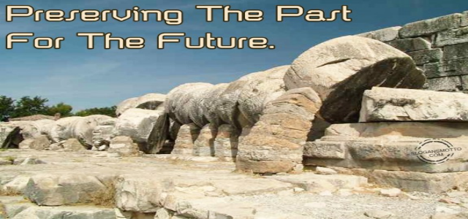
These World Heritage Sites in China maintain our culture, values and traditions.

Slide 16


Spelling Bee
Now 2 mins to test your spelling.
English-Chinese
valuable, dynasty, style, jewel, artist, wooden, former, castle, trial, evidence, entrance, informal
Chinese-English
幸免，寻找，挑选，装饰，属于，作为报答，移动，怀疑，拆开，爆炸，下沉，看重
When finishing, exchange your papers to see who does the best.

Slide 17



1. What do you know about amber?
2. What do you know about the Amber Room?
3. Why should we protect the Amber Room?

Slide 18


Homework
1. Find more information about
the Amber Room.
2. 发挥想象，连词成文(50-100词)。
in search of, select, design, fancy, decorate, belong to, in return, remove, less than, doubt

